Slide 1
Kyle Flynn, Hayden Townley, Sean G, and Alex Cross

Slide 2
Intended Progress
Working world generation
Character movement
Basic character/opponent creation
Basic combat mechanics
Basic networking/packet structure
Basic logger/adventure log
Screen/scene management
Entity Component System implementation
Basic Particle Systems

Slide 3
Current Progress
Basis for character creation/opponent creation
Basis for modular design of project
Start of user interface
Working network/packet structure
Basic logger/adventure log
Screen/scene management
Entity Component System implementation (Showcased next slide)
Advanced modular particle systems (Showcased following slides)
Rain, snow, lightning, text

Slide 4
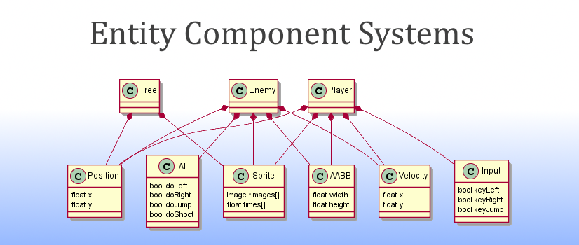
ECS - Full Implementation

Slide 5
Particle Example - Snow/Space

Slide 6
Particle Example - Rain

Slide 7
Problems Encountered
Introduction to SFML
Keeping a modular design
C++ peculiarities
const vs. non-const parameters/methods
Realizing that structs are almost always your best friends
Time Estimations
Issues requirements
Issues Not Completed
Player Menu
Dialogue GUI (logic storing/loading was implemented)
Character Movement

Slide 8
Future Goals
Sprint 3
Core Functionality
Movement
Basic Combat
World Generation
Object Generation
P2P Network
Sprint 4
Full Playability
Character Creation/Customization
Item/Equipment Implementation
Full Combat
Network Sharing/Updates
Questing
Beginning Zeus Functionality

